Slide 1

RESTAURANT BILLING
AKHIL S KUMAR
1NH17CS010
6 A

Slide 2
OBJECTIVE OF THE COURSE
    From this course, we will have a short research on the concept that is used for creation of a Graphical User Interface (GUI). i.e., Swing. Swing is a library of JAVA that provides many tools which is used for creation of a GUI.
    We can also have a glance about MySQL, which is the database that is being used in this project.
    We have also learnt how to connect JAVA to MySQL using a tool called JDBC.

Slide 3
ABSTRACT
Restaurant billing project is implemented using java programming language.
MySQL which acts as backend connectivity and swing and java AWT are used as front end to the project.
‘RESTAURANT BILLING’ software is designed to provide the users with various options. It helps in managing the food items.

Slide 4
OBJECTIVES OF THE PROJECT
The main aim of the project is to build a software which helps the admins and the cashiers of a restaurant to generate bill quickly according to the customers need.
Creating a database that holds the information which contains the details regarding the food items that are available in the restaurant.
And also creating a table which holds the details of each bill like bill number bill amount etc. helps the admin to calculate the collection of each day.

Slide 5
PROBLEM STATEMENT
As the number of customers in the restaurant increases it becomes difficult to write and calculate the bill for all the customers.
‘RESTAURANT BILLING’ software is designed to provide the users with options such as menu and generate bill.
It has an admin login where the admin will be able to add, update, delete the items from the menu and generate the bill.
It also has a cashier login where the cashier can only view the menu and generate the bill according to the customers need.

Slide 6
Functionality
It has an admin login where the admin login which has few operations that can be done.
1. INSERT FOOD
2. UPDATE FOOD
3. DELETE FOOD
4. GENERATE BILL
5. TRANSACTIONS
It also has a cashier login where the cashier can only view the menu and generate the bill according to the customers need

Slide 7
METHODOLOGY
Planning
System Analysis
Design
Specification
Disintegration
Development
Testing

Slide 8
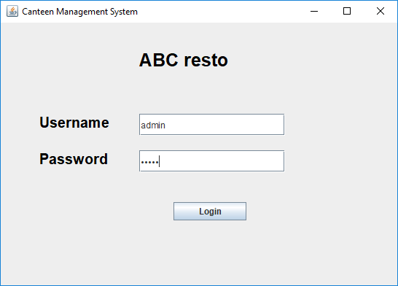
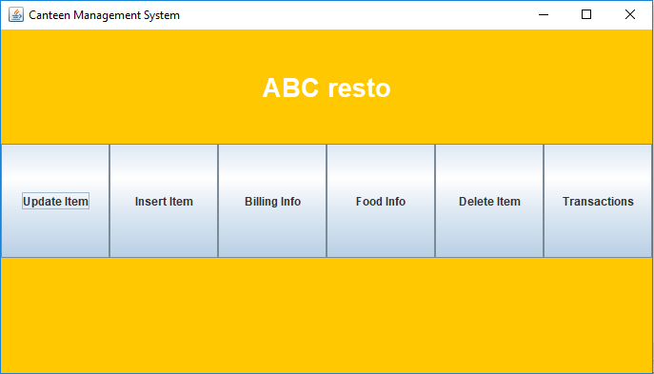
ADMIN LOGIN

Slide 9
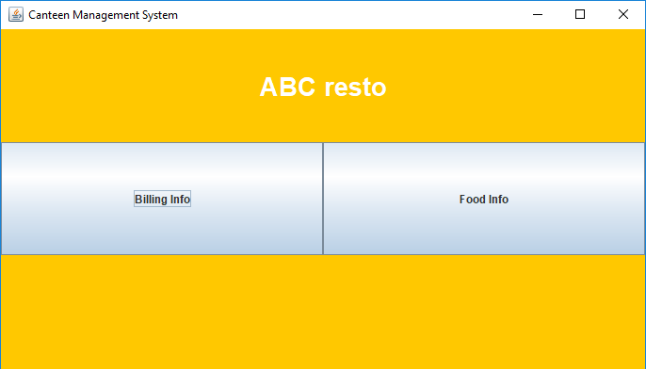
CASHIER LOGIN

Slide 10
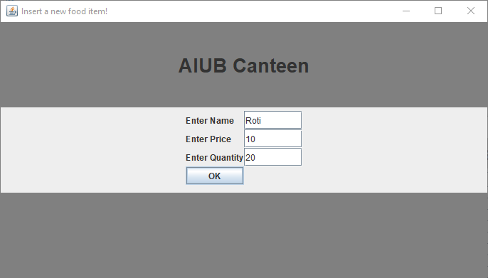
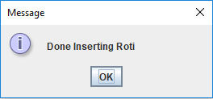
ADD FOOD

Slide 11
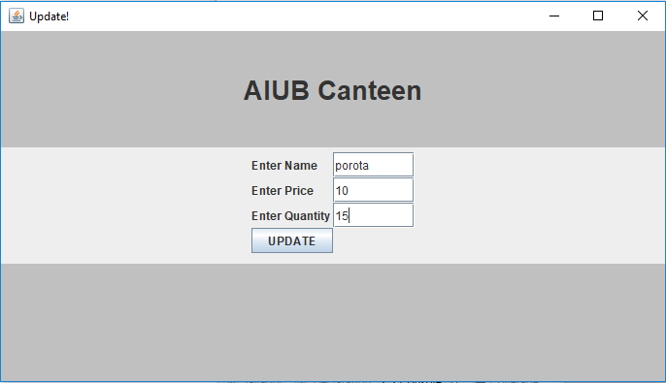
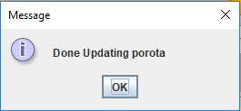
UPDATE FOOD

Slide 12
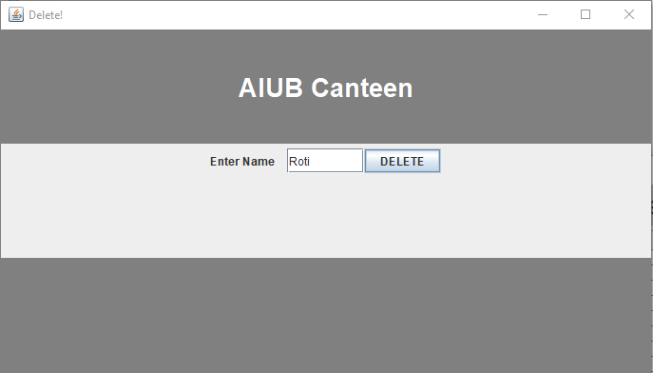
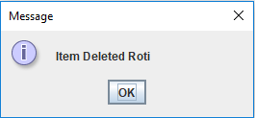
DELETE FOOD

Slide 13
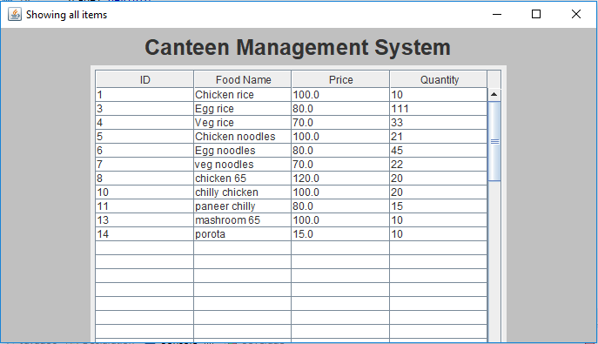
FOOD MENU

Slide 14
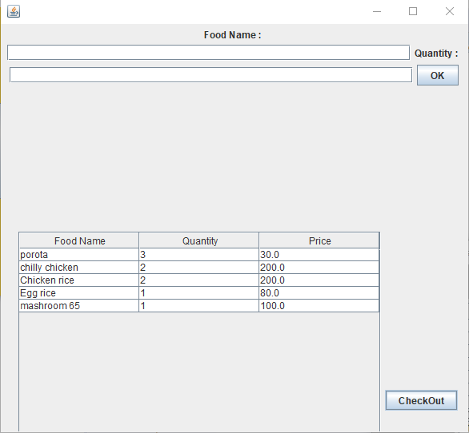
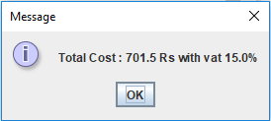
BILL GENERATION

Slide 15
OBJECTIVES ACHIEVED
We have learnt to use Java to create applications.
We have created a functional library management software.
We have learned to create an user friendly front-end using swing.
We have learned to create and use back-end using MySQL and JDBC.

Slide 16
THANK YOU

